Slide 1
Computing and Global Health Lecture 9 Behavior Change Communication
Winter 2015
Richard Anderson

Slide 2
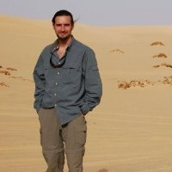
Today’s topics
Eduardo Jezierski
Behavior Change Communication
Projecting Health

Slide 3
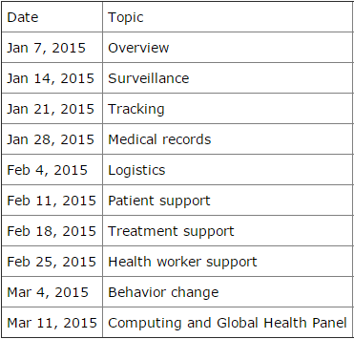
Readings and Assignments
Readings
Literacy Bridge
Village Reach
Homework 8
ODK
Homework 9
TBD
CSE 691, Gates Commons
6:30 PM

Slide 4
Behavior Change Communication
Vast improvements in health possible through behavior change
P₁
Good Outcome
Good Choice
Q₁
P₂
Bad
Choice
Bad Outcome
Q₂

Slide 5
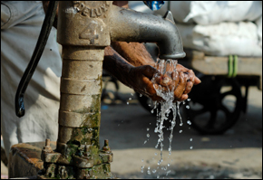
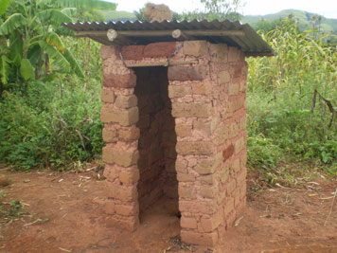
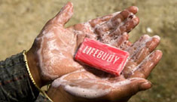
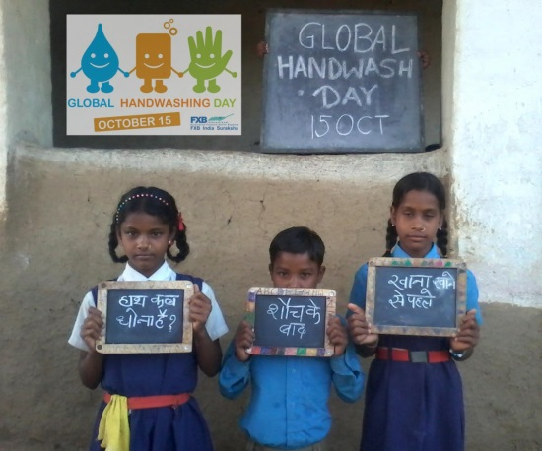
Sanitation

Slide 6
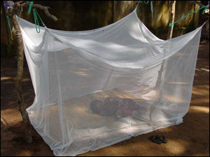
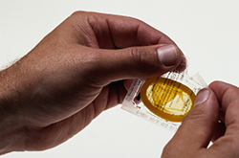
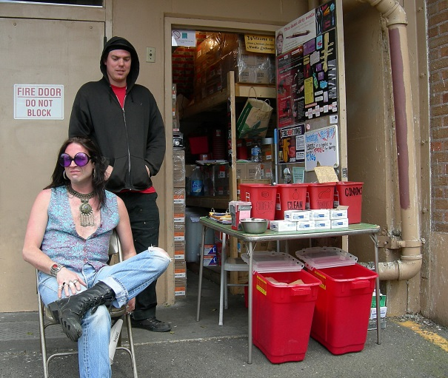
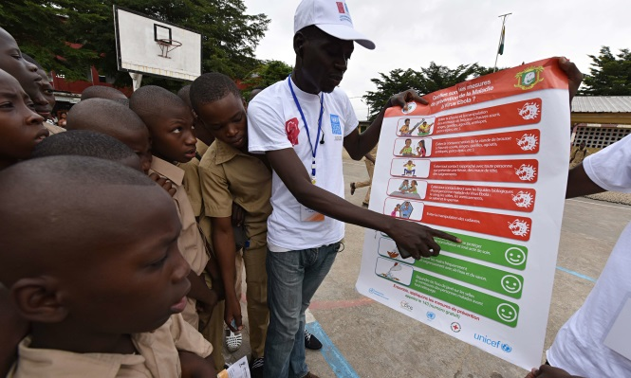
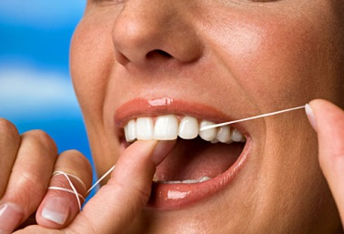
Disease Prevention

Slide 7
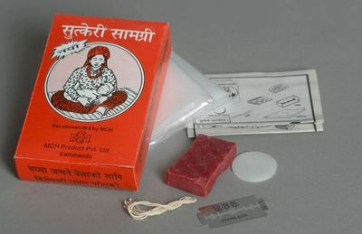
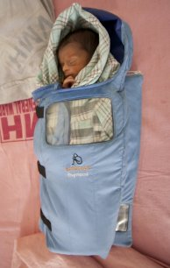
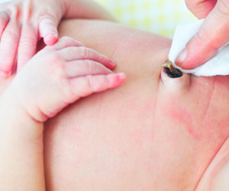
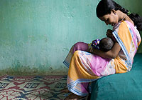
Maternal and Child Health

Slide 8
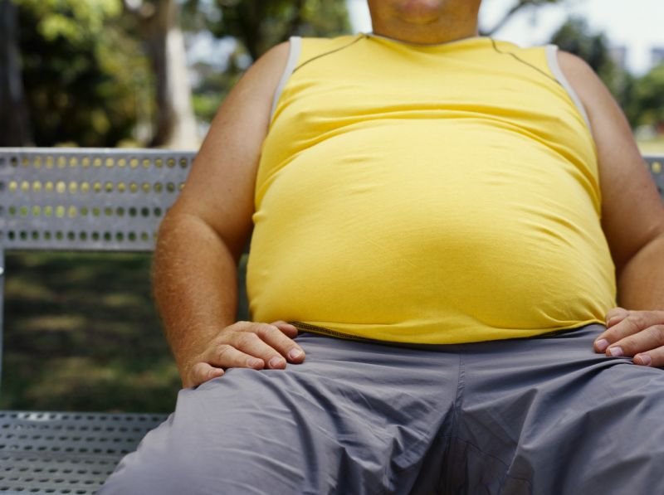
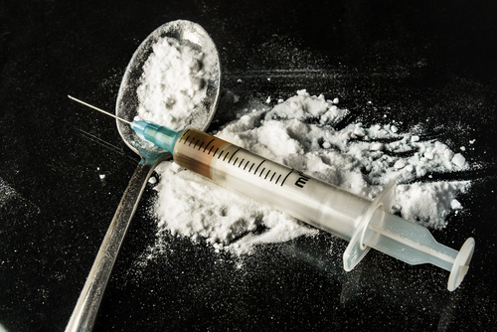
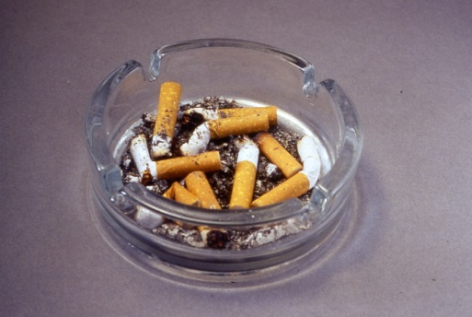
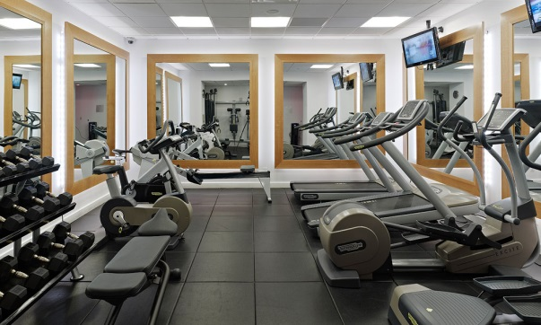
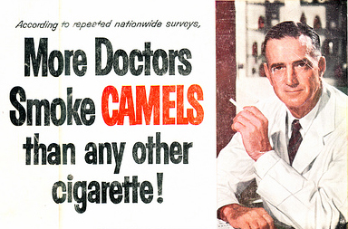
Lifestyle

Slide 9
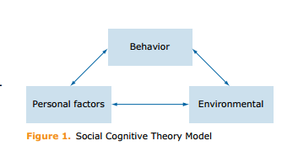
Theory
Social cognitive theory
Key variables
Self-efficacy
Outcome expectations
Self control
Reinforcements
Emotional coping
Observational learning
Behavior explained as interaction of personal factors and environment

Slide 10
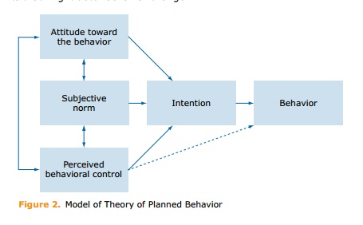
Theory
Theory of Planned Behavior
Behavior is dependent on intention to perform the behavior
A person must perceive they have ability to perform behavior

Slide 11
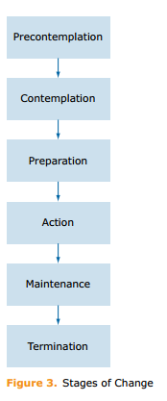
Theory
Stages of change model
By default, people will get stuck in early stages
Different types of action empirically shown to help progress

Slide 12
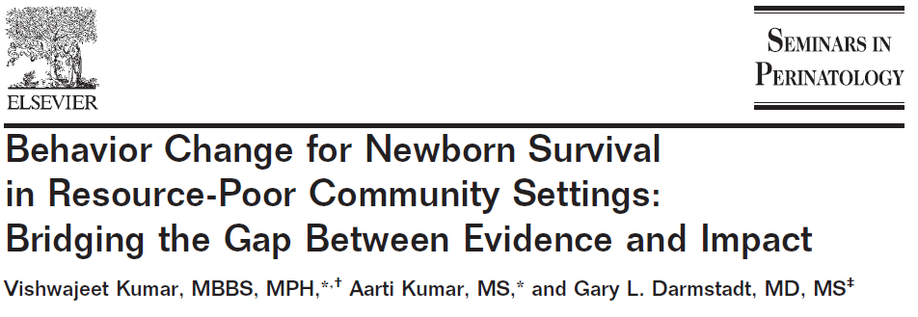
Behavior Change for Newborn Survival
Clean delivery, thermal care, breast feeding, folic acid supplementation, antenatal care, tetanus vaccination, awareness of danger signs, extra warmth for low birthweight babies
Specific interventions can reduce neo-natal and maternal mortality

Slide 13
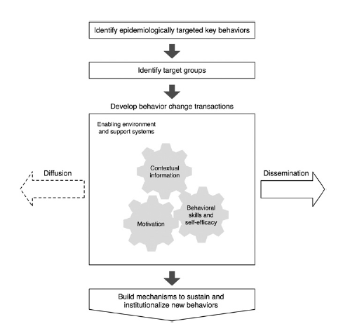
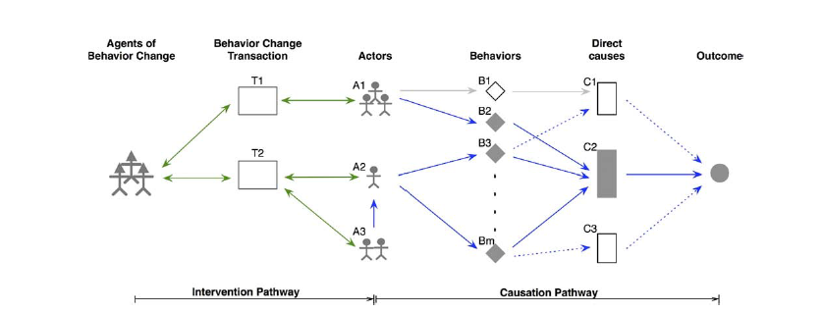
Behavior change management
1. Identify epidemiologically targeted key behaviors.
2. Identify suitable target groups for a behavioral intervention.
3. Develop appropriate behavior change transaction(s) for each target group.
4. Leverage the influence of social networks to expedite behavior change.
5. Build mechanisms to sustain and institutionalize new behaviors.

Slide 14
Lifestyle vs Newborn Care Behavior
 | Lifestyle/Addictive | Newborn Care
Locus of behavioral action | Individual | Family
Behavioral context | Psychosocial: rooted in individual experience | Sociocultural: rooted in cultural value system
Perceived risk | Usually aware of some risk | Not aware of risks
Perceived barriers | Habit patterns, pleasure/pain choices | Cultural factors enforced by social norms
Mode of behavioral transmission | Peer-to-peer | Transmitted along generations through familial hierarchy
Social sanction | Not valued by society as a whole | Usually the norm with universal social sanction

Slide 15
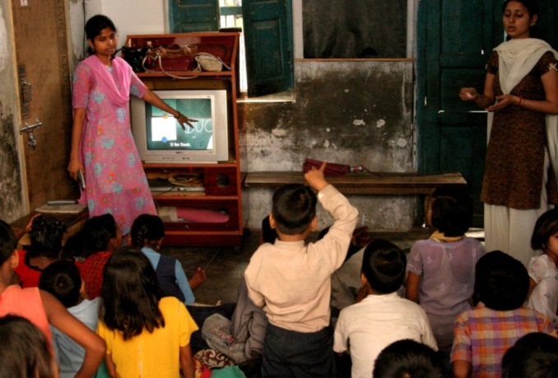
From Digital StudyHall to Digital PublicHealth

Slide 16
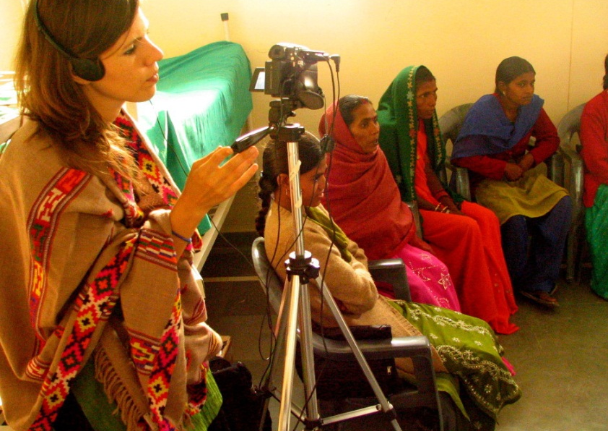
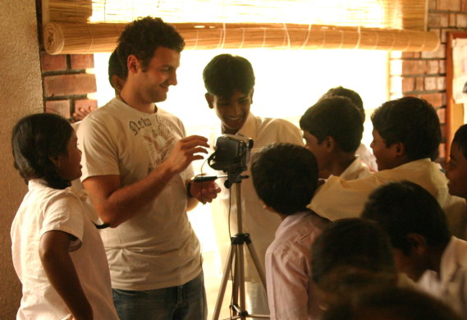
The History of D*
Digital StudyHall pioneered a technology and methodology for remote education with low cost digital video
D* designated the use of the DSH platform to multiple domains
Digital Green (DG) for agriculture
Digital PolyClinic (DPC) for health
Digital Self Employment (DSE) for livelihood

Slide 17
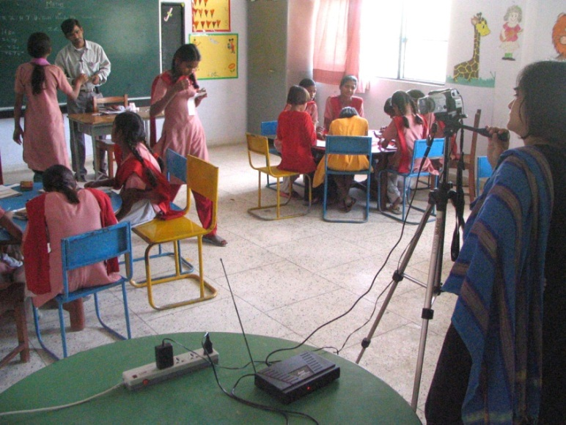
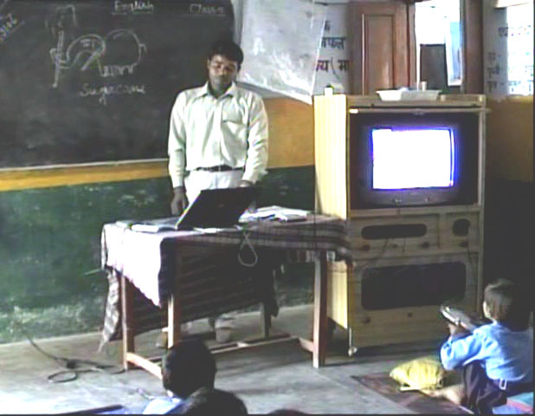
Digital StudyHall
Support weak schools with video content from expert teachers
Local teacher mediates the video content
Based on the TVI model
Provide better content and support teacher development
Important to match content with target audience
Cost realism

Slide 18
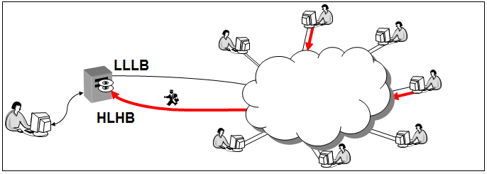
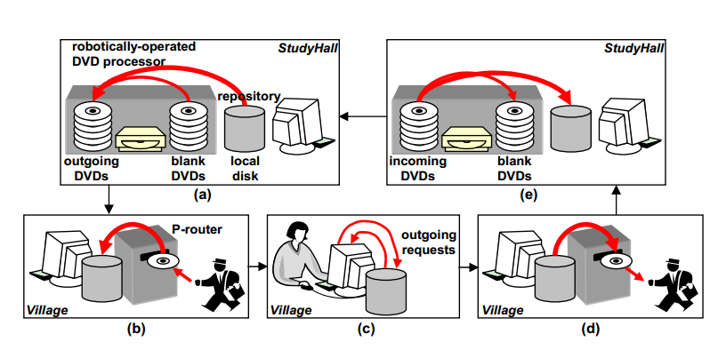
DSH History: The Idea
How can computing systems research be applied to help the very poor?
Solve the digital content distribution problem to make distance education possible
Concept paper, Randy Wang et al., Princeton, November 2003

Slide 19
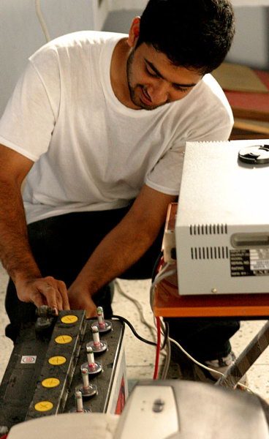
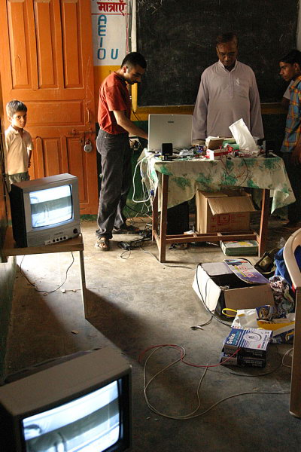
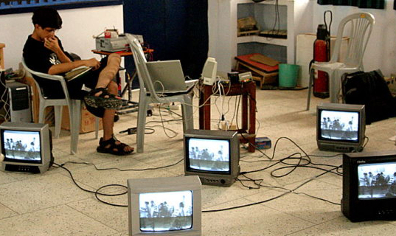
DSH History: Experimentation
Minimize cost of video playback in the classroom
Attempt to use low cost television sets
Target rural schools with irregular power
Low cost video and audio production
Develop video production tools based on open source software
Randy Wang joins MSR (TEM Group)

Slide 20
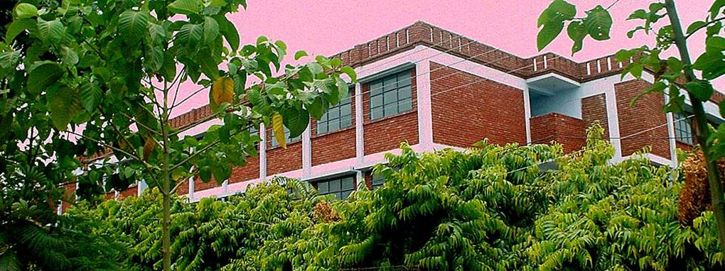
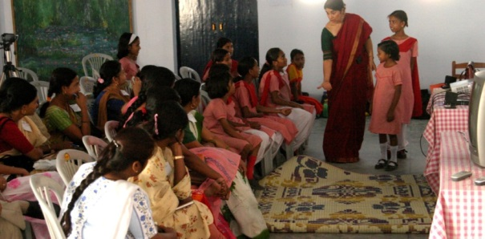
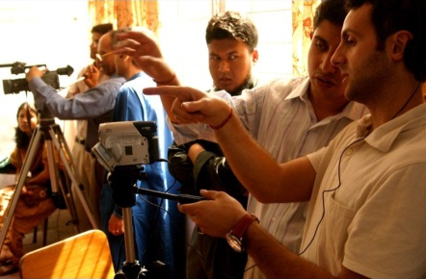
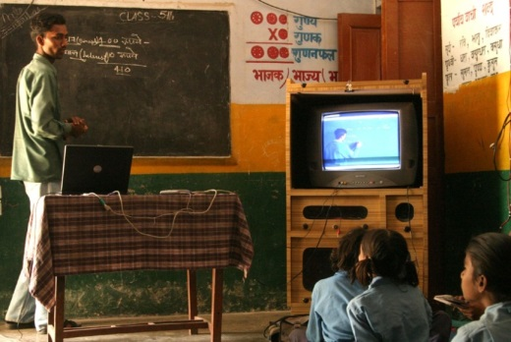
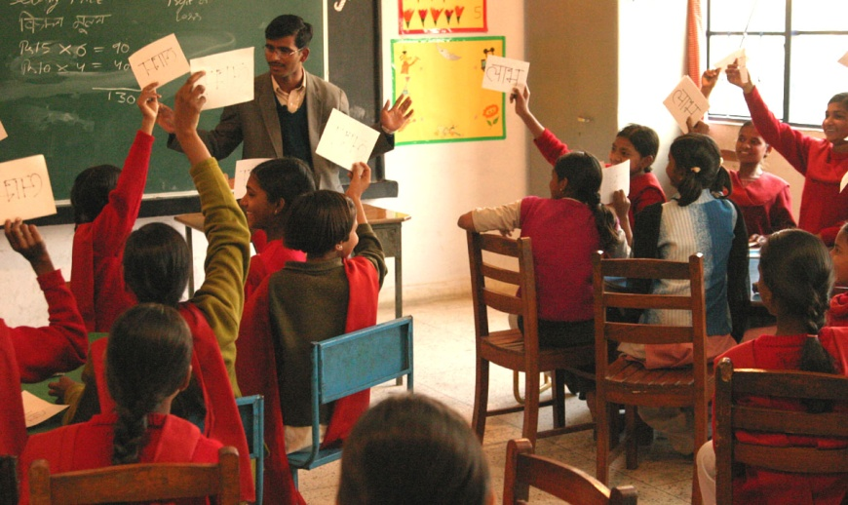
DSH History: Building the Lucknow hub
Developed content creation model with a strong school
Recorded core content for all grades
Teacher training workshops
Range of different types of schools
Government, private, informal
Simplification of the technology
DVD players instead of computers
Randy Wang joins TEM Group at MSR
Expansion to other HUBs
Bangalore, Pune, Dhaka, Calcutta

Slide 21
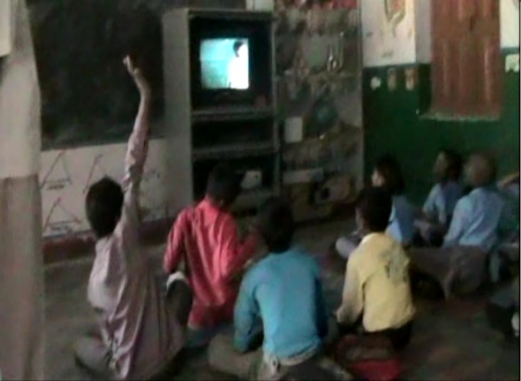
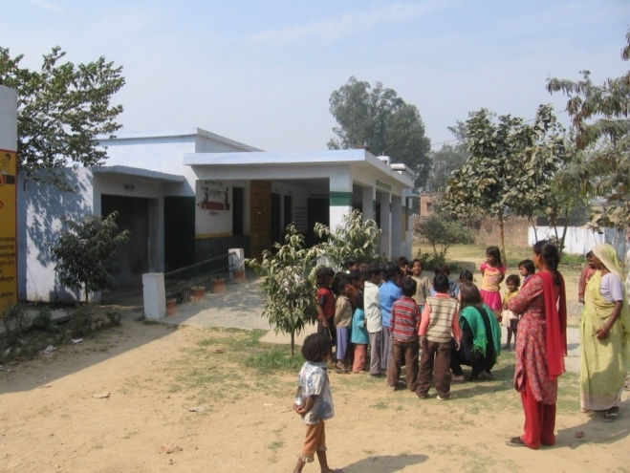
DSH History: Independence
Relationship with MSR ended in 2008
Activities in Lucknow continued, but many hubs stopped working
NSF sponsored study exposed challenges in working with government schools
Randy Wang moved to Intel, Shanghai in 2010
New set of projects developed by DSH Lucknow with a new manager

Slide 22
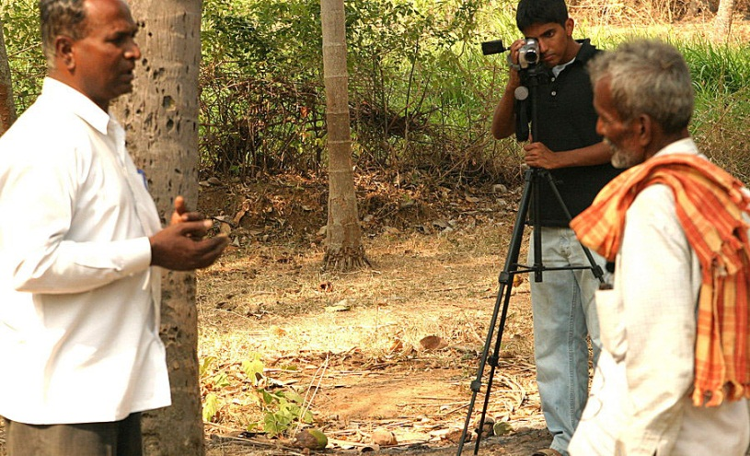
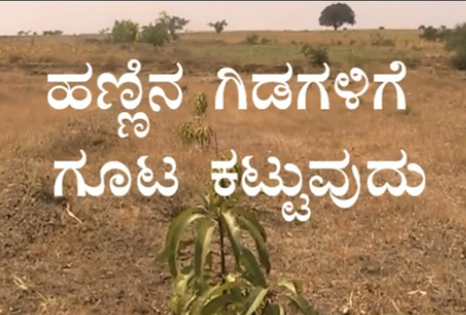
Digital Green
Video based education for farmers
Community created videos demonstrating agricultural practices
Facilitated showings of videos in farmer groups
Digital Green (NGO) providing technology, training, content archive and advocacy

Slide 23
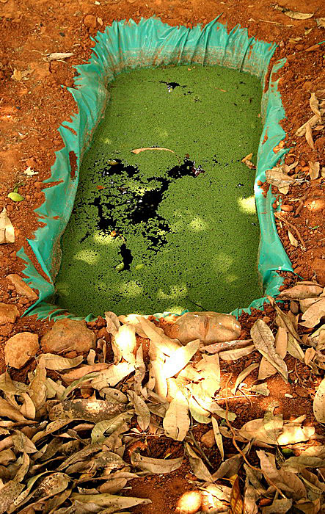
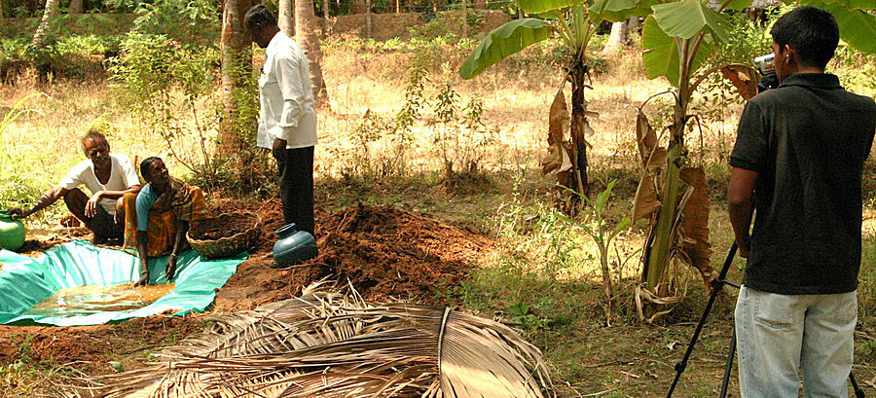
DG History: The Idea
Apply Digital StudyHall to agriculture
Formative research conducted with Bangalore based NGO (Green)
Promote organic farming practices
Film extension workers introducing practices
Public showings in evenings
Rikin Gandhi started work at MSRI as a volunteer

Slide 24
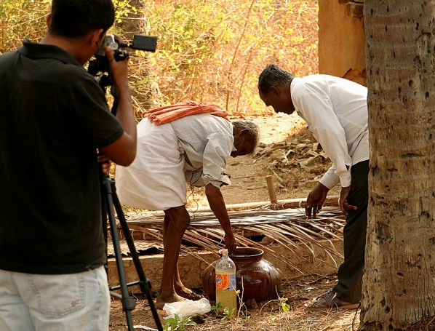
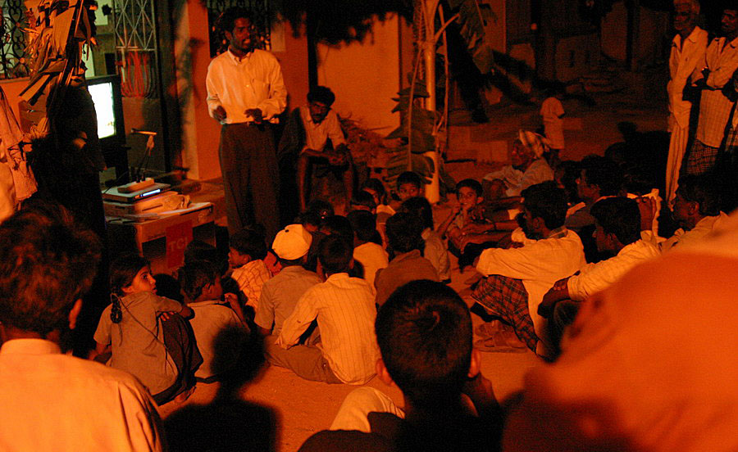
DG History: Experimentation
Video creation
Wide range of topics and video styles
Screening methodologies
In homes
In public square
Process
Hire ‘animators’ responsible for conducting showings and maintaining equipment
Follow up from meetings

Slide 25
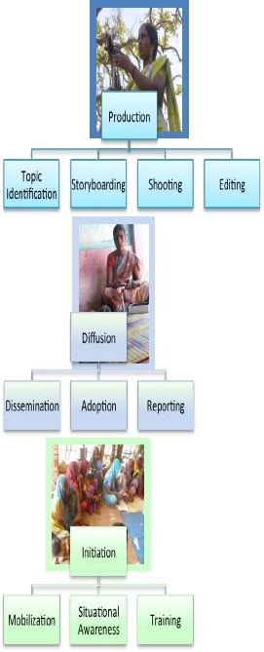
DG History: Spin Out
Studies measuring “cost per adoption”
Compare DG with extension agent
Emphasis on monitoring
Microsoft identified forming an NGO as a success criteria for the project
Support from BMGF to form NGO

Slide 26
DG History: Building an NGO
Business model
Partner with NGOs implementing agricultural programs
Become trainers and managers of content and technology
Shift focus to low income states in India
Strengthen process model
Process innovation:
Shift video creation to the community
Technology innovation:
Pico-projector

Slide 27
DG History: Expansion
Substantial growth
Partnership with NRLM in India
Expansion to projects in Africa
Identification of other domains
Health, Sanitation, Nutrition, Livelihood

Slide 28
Digital Public Health
Digital Green model applied to community health education
Community created video content for externally defined health messages
Video showings in community to promote behavior change
* Now known as Projecting Health

Slide 29
DPH History: Building a Partnership
PATH/DG partnership established
DG Video Training workshop for PATH staff
Identification of possible differences between Health and Agriculture
Message review
Evaluation of impact
Dissemination models
Funding for pilot
Identification of implementation partner

Slide 30
Applying the Digital Green model to health
Digital Green model
Participatory process for content production
Locally generated digital video database
Human-mediated instruction for dissemination and training
Regimented sequencing to initiate a new community
Integrated performance monitoring

Slide 31
Surestart project
PATH led project in UP and Maharashtra
2006-2011, BMGF Funded
Community engagement to support maternal and newborn health
Governance and public health interventions
Mentoring ASHAs
Maternal health messaging
Danger signs
Birth preparedness
Thermal care
Breast feeding
Mothers’ group
ASHA led group of expecting mothers
Monthly meeting with activities

Slide 32
Bacchrawan, Raebareli, UP
Gran Vikas Sanstham
Well established local NGO
Active since 1977
Demonstration site for SureStart
High performing district
Project initially covered 20 villages with 54 mothers’ groups
Direct continuation of Surestart
Supervisory structure already in place
Expansion to another 80 MGs’ in 2013

Slide 33
Message creation
Health messaging developed by experts
Standard messaging that has been adopted by health organizations
List of messages for a topic given to video team
Messages must appear in the video

Slide 34
Video creation
GVS employees trained in video production and editing
No previous background
Training includes basics of film
Different types of shots
Video team had creative control on videos
Developed story lines for videos
Initial videos produced were of high quality

Slide 35
Review
Critical to ensure accuracy of messaging
Community advisory board created
Health system and community membership
Approvals
Storyboards
Final videos
Community and PATH review
Recommendations from CAB have been included in videos
Errors in videos have been detected

Slide 36
Dissemination
ASHAs trained to use videos
Technical training on Pico projector
Training in facilitation
Videos shown in existing mothers groups
Substitute videos for learning activities
Attempt to keep format the same

Slide 37
Technology
Video creation with Kodak playtouch camera
Edit with Microsoft Movie Maker
(sound problems)
Video sharing for review
Post to YouTube
Load on Pico projector for showings

Slide 38
The Projecting Health Process
Identify topic
Produce short video
Identify local actors
Create storyboard and approve
Develop key messages
Share and discuss
Women identify with actors and issues in videos
Women discuss and share their knowledge with others
Women adopt healthier behaviors and practices

Slide 39
Overall Project Achievements - India
 | Partner 1: GVS | Partner 2: NYST | Total
Villages implemented in | 27 | 57 | 84
Community health workers trained | 55 | 81 | 136
Number of people in video production teams trained | 8 | 6 | 14
Mother’s Groups | 55 | 81 | 136
Videos Produced | 21 | 13 | 34
Screenings | 2,139 | 2,100 | 4,239
Women reached by groups | 10,871 | 13,938 | 24,809

Slide 40
Projecting Health Videos
Breastfeeding
Thermal care
Optimal breastfeeding practices
Exclusive breastfeeding
LAM
Thermal care overview
Delay bathing
Family planning
Cord care
Permanent methods
Temporary methods
NSV-No scalpel vasectomy
IUCD Copper-T
Cord care overview
Myths and misconceptions
Birth preparedness
Other
Birth preparedness overview
Maternal danger signs
Maternal nutrition
Newborn danger signs
Immunizations
Community-based emergency transportation systems

Slide 41
Projecting Health Theory of Change
With:
Achieved through:
Resulting in increased adherence/uptake in MNH practices such as:
Improve maternal and neonatal health in UP, India
ASHAs
Behavior change messages developed by community delivered through an intervention package: videos, discussion in mothers groups
Birth preparedness
Improved capacity of ASHAs
Mothers + extended family/ support person
Breastfeeding practices
Knowledge increased
Community/health care workers
Thermal Care
Cord Care
Internalizing messaging to adopt behaviors
CBOs
Family planning
Increased acceptance of messages over time and exposure
Notes:
Increased acceptance of messages

Slide 42
Endline Evaluation: Objectives
Primary objective:
To assess the effectiveness of the PH intervention in increasing knowledge and changing practices of the women between ages 18 and 45 exposed to the video messages on key maternal and neonatal health (MNH) areas.

Slide 43
Endline Evaluation: Key Outcomes
Maternal and neonatal health (MNH) areas and focus outcome indicators
Birth Preparedness | Breastfeeding
Identify a place to deliver Institutional delivery Saving money for an emergency Planning for emergency transport Preparing blade, thread for cord cutting Prepare a clean cloth for wrapping baby after birth | Gave colostrum Early initiation of breastfeeding within 1 hour of birth Exclusively breastfed for 6 months

Slide 44
Endline Evaluation: Key Outcomes
Thermal Care | Cord Care | Family Planning
Bathed baby between 3 -7 days after birth Held baby skin to skin or wrapped in a clean cloth after birth | Cord was cut using a clean blade and tied with a clean cord Nothing was applied to the cord | Using a family planning method (temporary or permanent)

Slide 45
Evaluation design
Comprehensive evaluation (July 2013-July 2014)
Post-only study design with 3 arms:
Projecting Health (Arm A)
Knowledge/behavior (in %)
PH + Capacity building Effect
A₁
PH Effect
Standard MG(Arm B)
B₁
Capacity building Effect
C₁
Comparison (Arm C)

Slide 46
Methods
Household survey with structured questionnaire among women between 18-45 years
Participants selected using set criteria, intervention arms recruited from participant list, and comparison arm from a household listing exercise
Semi-structured interviews with community healthcare workers (ASHA)
Ethical approval from REC and the local UP-based IRB
Data collected by external organization, June-July 2014

Slide 47
Sample villages
Block: KHIRO
Block: SARENI
 | Intervention Arm A |  | Intervention Arm B |  | Comparison arm C

Slide 48
Findings overview
Practices of women
Knowledge of women (spontaneous response)
Source of knowledge
Sharing of messages with others

Slide 49
Respondents
Attributes | Projecting Health | Standard MG | Comparison
Total (n) | 309 | 321 | 327
Mean age of respondents (years) | 26 | 26 | 26
Mean number of live births (n) | 2 | 2 | 2
Literacy : Illiterate (%) | 33 | 30 | 29
Occupation: Housewife (%) | 90 | 93 | 88
Religion : Hindu (%) | 94 | 92 | 95
Religion: Muslim (%) | 6 | 8 | 5

Slide 50
Self reported practices
*
*
*
Percentage of women
*p<.0.001

Slide 51
Birth Practices: Women Who Delivered at Home
Percentage of women
*p<.0.001

Slide 52
Breastfeeding: Uptake of Optimal Practices
Percentage of women

Slide 53
Birth Preparedness: Change in Knowledge
Percentage of women

Slide 54
Current work

Slide 55
Next week
Panel discussion, CSE 691
Cliff Schmidt, Literacy Bridge
Emily Bancroft, Village Reach
Brian Taliesin, PATH

